Slide 1

The Jeanne Clery Campus Safety Act: CLERY ACT
The Clery Act: Compliance Basics, Managing Campus Protests, and Understanding Emerging Trends
Anna Archila and Donald Tantum
U.S. Department of
Education 2026 TCU Summer Conference

Slide 2
DISCLAIMERS
This presentation includes discussion of violent crime and related topics that may be disturbing for some audience members.
This session is intended to provide general information about the Clery Act and related laws. It does not represent a complete recitation of the applicable law or ED/FSA policies and is for discussion purposes only.
This presentation is intended exclusively for participants in FSA’s 2026 TCU Conference. This material must not be used for any other purpose. Actual compliance determinations must be made after a careful analysis of specific facts on a case-by-case basis.
Comments made during this presentation are for instructional and illustrative purposes only and are not intended for attribution or publication.

Slide 3
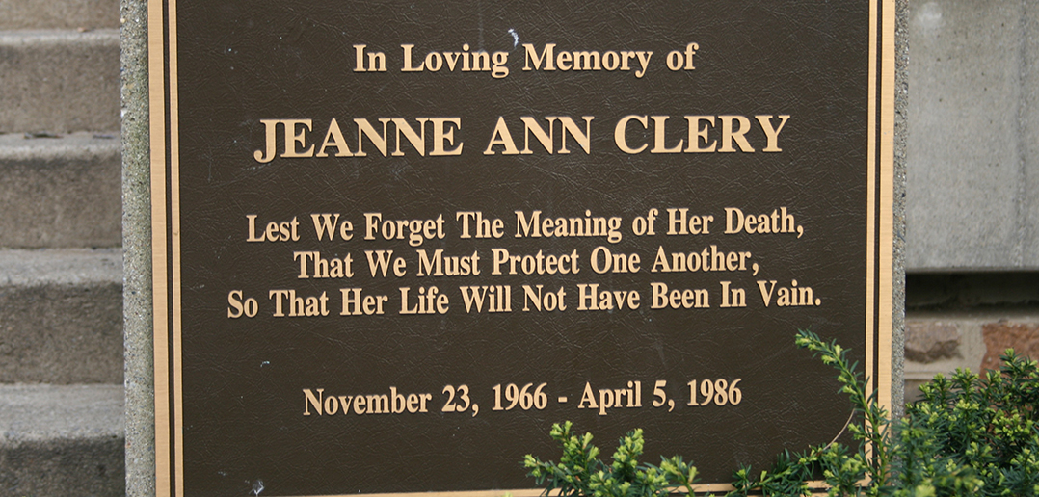
WHAT IS THE CLERY ACT? WHY DO WE HAVE IT?
HOW DID WE GET HERE?

Slide 4


Jeanne Clery Campus Safety Act (Clery Act)
Requires colleges and universities across the United States to disclose information about crime on and around their campuses. 34 CFR § 668.46.
The Clery Act is named in memory of 19 years old Lehigh University freshman Jeanne Ann Clery, who was raped and murdered while asleep in her residence hall room on April 5, 1986.

Slide 5
THE CLERY ACT TODAY
People, Not Paper
Increasing focus on student wellness - anti-hazing, suicide prevention
Campus safety, crime prevention, consumer protection remain job #1
Emphasis on team approach to problem-solving and risk mitigation
The essential nature of training and wellness programming for all stakeholder groups
Importance of strong partnerships with community & law enforcement
• Creating an environment that fosters a “Culture of Transparency”
5

Slide 6
STRATEGIES
For Success and Effective Risk Management
INVOLVED LEADERSHIP
Senior leadership
and board members are actively engaged
TRAINING & NETWORKS
Invest in training and
technical assistance opportunities and build a practitioner network
CONSULT STAKEHOLDERS
Understand the
concerns of ALL of your constituent and stakeholder groups – Expectations, Limitations, Pain Points, and Irreconcilable Differences

Slide 7
STRATEGIES
For Success and Effective Risk Management
PREPARATION
Be aware of the next
thing. Notice of Proposed Rulemaking for Title IX issued June 2022
IDENTIFYPITFALS
Beware of “special
rules for special talents”
ACCOUNTABILITY
Be responsive and
transparent in your dealings with the Department and other oversight entities

Slide 8
ADMINISTRATIVE CAPABILITY
To participate in any Title IV program, an institution must demonstrate that it is capable of adequately administering the program under the standards established by the Secretary, including:
Employing “an adequate number of qualified persons”
Ensuring that programs are administered with appropriate “checks and balances” in a system of “internal controls”
Implementing written procedures that document the responsibilities of institutional officials with respect to the “preparation and submission of reports to the Secretary”
Does your school meet the mark?
8

Slide 9
CURRENT LAW
The Clery Act campus safety and crime prevention provisions require all participating schools to:
  Classify crime reports and compile and disclose accurate crime statistics
  Publish and actively distribute an Annual Security Report (ASR) that contains all required statistical and policy disclosures (50+)
  Submit required crime statistics to the Department of Education
  Issue timely warnings and emergency notifications
  Maintain a Daily Crime Log
  Emergency evacuation and response procedures
  Housing: Missing person notifications and fire safety
  Stop Campus Hazing Act (SCHA) (P.L. 118-173 enacted into law 12/23/2024)
Violence Against Women Reauthorization Act of 2013
  Requires expanded reporting for incidents of sexual assault, dating violence, domestic violence and stalking (including cyber stalking)
  Requires that the ASR include additional information about policies, procedures and training programs
aimed at sexual assault prevention and response
Expands accommodations and protective measures requirements
9

Slide 10
CLERY ENFORCEMENT
Compliance Assessments
Finding Consultation Program
Campus Crime Program Reviews
Fine Action Support
Key Findings
Settlement Agreement
Post-Review Monitoring
10

Slide 11
Stop Campus Hazing Act: Key Compliance Changes
January 1, 2025: Institutions should begin collecting hazing statistics to include in the annual security report.
June 23, 2025: Hazing policies must be in place.
July 1, 2025: Institutions must have a process for documenting violations of the institution’s standards of conduct relating to hazing.
December 23, 2025: The Campus Hazing Transparency Report, which includes the violations that institutions begin documenting in July, must be publicly available. This report is distinct and separate from the ASR requirements and must be updated at least two times a year.
October 1, 2026: Hazing statistics will first be included in the 2026 annual security report (2025 statistics).

Slide 12
Stop Campus Hazing Act: 3 Primary Components
Inclusion of hazing statistics in annual security reports: Colleges and universities will need to include statistics for hazing incidents that were reported to campus security authorities or local law enforcement, as defined by SCHA, in their annual security reports.
Implementation of hazing policies, including those specific to hazing prevention: Colleges and universities will be required to have a hazing policy with information on how to make a report of hazing and the process used to investigate hazing incidents. They must also have a policy that addresses hazing prevention and awareness programs, which includes a description of research-informed campus-wide prevention programs and primary prevention strategies.
Compilation of a Campus Hazing Transparency Report (CHTR): Each institution must compile and publish on a prominent location of their public website a hazing transparency report that summarizes findings concerning any student organization found to be in violation of the institution’s standards of conduct related to hazing. The report will include:
  The name of the student organization;
  A general description of the violation that resulted in a finding of responsibility; and
  Related dates (the date of the alleged incident, the date of the initiation of the investigation, the date the investigation ended with a finding, and the date the institution provided notice to the organization of the finding).

Slide 13
REALITIES OF CRIME
Campus crime in the U.S. is a complex mix of reported incidents, underreporting, and evolving risk factors, with significant implications for student safety and institutional responsibility.
Statistical trends;
Severe underreporting;
Evolving risk factors;
Gap between comprehensive, essential.
public perception and actual safety levels, making
transparent, and collaborative safety strategies
13

Slide 14
CLERY-REPORTABLE
CRIMES
Crime is everywhere
Crime moves
Statistics must be disclosed for each of four separate categories (when an incident meets definitions in more than one of those categories, it must be reported in each category)
“Reported” means that an incident was brought to the attention of a campus security authority or to local law enforcement. An incident cannot be “unreported” but can be “unfounded” by law enforcement under certain conditions
Schools are also required to request crime statistics
Criminal Offenses
Hate Crimes
Arrests and Referrals for Disciplinary Action
VAWA
Offenses
from local law enforcement agencies
14

Slide 15
HATE CRIMES
Hate Crime: A criminal offense that manifests evidence that the victim was intentionally selected because of the perpetrator’s actual or perceived bias against the victim
  The Clery Hate Crime provisions apply to all Clery-reportable offenses as well as the crimes of Intimidation, Larceny, Simple Assault, and Vandalism/Destruction of Property
  Categories of Bias: Race, Religion, Sexual Orientation, Gender, Gender Identity, Ethnicity, National Origin, and Disability

Slide 16
HATE CRIMES
Destruction/Damage/Vandalism of Property: To willfully or maliciously destroy, damage, deface, or otherwise injure real or personal property without the consent of the owner or the person having custody or control of it.
Intimidation: To unlawfully place another person in reasonable fear of bodily harm through the use of threatening words and/or other conduct, but without displaying a weapon or subjecting the victim to actual physical attack.
  Intimidation is a form of assault.
  Intimidation crimes can be committed remotely or by electronic means.

Slide 17
RIGHT TO KNOW
Safety Alerts - Focus on Clarity and Transparency
Institutions must issue two types of safety alerts to provide students and employees with important information about significant and/or ongoing threats due to crime or other dangerous conditions
TIMELY WARNINGS
Issued for Clery-reportable crimes that may pose a serious ongoing threat (Clery Geography)
EMERGENCY NOTIFICATIONS
Issued upon confirmation of any significant emergency or dangerous situation that may pose an immediate threat to health or safety (Campus Only)
15

Slide 18
CAMPUS SECURITY AUTHORITIES
PUBLIC SAFETY OFFICIALS
Any members of a campus law enforcement or public safety entity
ASSIGNED SAFETY RESPONSIBILIT IES
Any individual who has responsibility for campus safety but is not part of a campus law enforcement or public safety entity (e.g., hall monitors, parking attendants)
STUDENT OR CAMPUS ACTIVITIES
An institutional official with significant responsibility for student and campus activities
INSTITUTIONA LLY IDENTIFIED
Any other individual to whom students and employees are directed to report crimes
19

Slide 19
CAMPUS SECURITY AUTHORITIES
Campus Law Enforcement and Campus Public Safety Professionals
Campus Leadership and Administrators
Residence Life Staff including Resident Assistants
Athletic Directors and Coaches
Study-Abroad Program and Foreign Campus Administrators
Student Life and Student Organizations Staff, including Student Leaders
Title IX Coordinators and Staff
MOST COMMON CSA CATEGORIES
Campus Security Authorities are commonly found among the following types of groups:

Slide 20
CSA KNOWLEDGE CHECK AND DISCUSSION
How many CSAs does your school or campus have?
How does your school notify CSAs of their reporting responsibilities?
What documentation does your school keep to show that CSAs have been notified of their reporting responsibilities?
Do CSAs at your school receive any training?

Slide 21
“CLERY GEOGRAPHY” DEFINED
CAMPUS I
Any building or property owned or controlled by an institution within the same reasonably contiguous geographic area and is used by the institution in direct support of, or in a manner related to, its educational purposes, including residence halls
CAMPUS II
Any building or property that is within or reasonably contiguous to the area identified above that is owned by the institution but is controlled by another person or entity, is frequently used by students, and supports institutional purposes (such as food or other retail vendor)

Slide 22
“CLERY GEOGRAPHY” DEFINED
NON-CAMPUS BUILDING OR PROPERTY PUBLIC PROPERTY
(1) Any building or property owned or controlled by a student organization that is officially recognized by the institution; or
All public property including thoroughfares, streets, sidewalks, and parking facilities, that is within the campus, or immediately adjacent to
(2) any building or property (other than a separate campus) ^{or accessible from the campus.} owned or controlled by an institution that is used in
direct support of, or in relation to, its educational purposes, is frequently used by students, and is not within the same reasonably contiguous geographic area
- “mobile” campuses and sea-faring vessels.

Slide 23
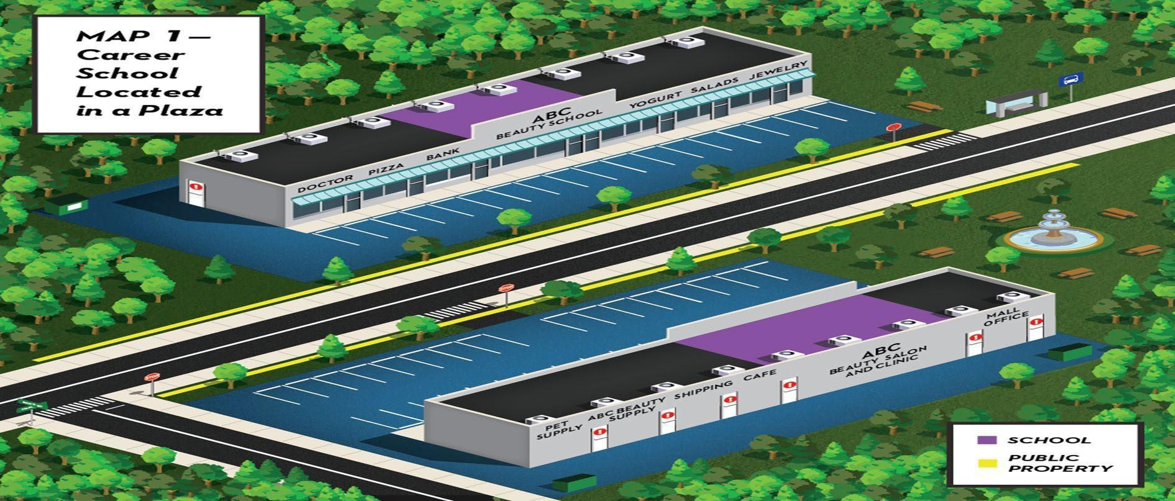
CLERY GEOGRAPHY SIMPLIFIED

Slide 24
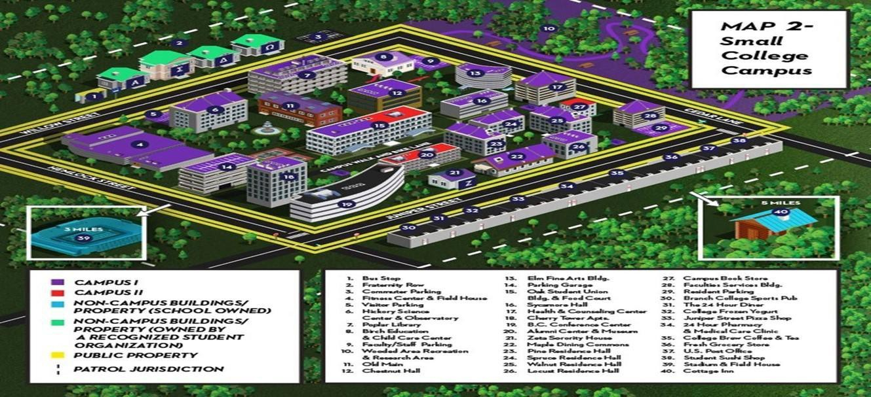
CLERY GEOGRAPHY SIMPLIFIED

Slide 25
EMERGENCY EVACUATION & RESPONSE
An institution must include a statement of policy regarding its emergency response and evacuation procedures in the annual security report. This statement must include:
  A clear explanation of the methods that the school will use to immediately notify the campus community about any immediate threat to the health or safety of students or employees occurring on the campus
  A description of the process the institution will use to confirm the presence of such a condition
An institution must also determine the segment or segments of the campus community that need to receive the notice then quickly determine the content of the notice and initiate the notification system

Slide 26
EMERGENCY EVACUATION & RESPONSE
An institution’s EE&R procedures must also include:
  A list of the titles of the person or persons or organization or organizations responsible for carrying out the notification process
  The process that will be used to disseminate emergency information to the larger community
  Procedures for testing the effectiveness of the emergency response and evacuation system on at least an annual basis
  Information about testing of the procedures.Such notice must state whether the tests will be announced or unannounced and include a description of the test, date, time, and a summary of the outcomes
27

Slide 27
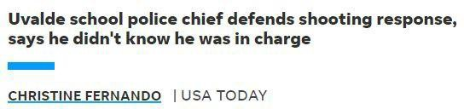
“PRACTICE, PRACTICE, PRACTICE”
June 10,
2022

Slide 28
WHAT’S THE PLAN?
How do we develop an Emergency Management Action Plan?
ONE
TWO
THREE
FOUR
FIVE
 |  | Conduct a Risk Assessment |  | After-Action
Get Organized | Identify Hazards (“All Risk/ Threat Basis”) |  | Develop/Update the Emergency Management Plan | Reporting and Implement Revised Emergency Management
 |  |  |  | Plan

Slide 29
EMERGENCY MANAGEMENT BASICS
Train key staff on their primary duties
Coordinate with local law enforcement and emergency managers
Develop and implement a comprehensive emergency management plan
Maintain a “close hold” on key components of the plan
Customize plans for each campus to account for differences (size; location; available resources/support; vulnerable targets; etc.)
Plan for foreseeable contingencies
Use technology to improve emergency operations
De-escalation, use-of-force, and implicit bias training
Conduct after-action reviews and adjust policies and procedures as needed
EMERGENCY MANAGEMENT
Every school needs to have an emergency evacuation and response plan.
Here are a few plan components to consider:
28

Slide 30
PLANNING FOR PROTESTS, DEMONSTRATIONS, AND ENCAMPMENTS
Facilitate campus conversations on key issues
Communicate expectations & Mission, Vision, & Values
Educate community on the 1st Amendment and its limitation, related laws, and institutional policies
Alignment, communications, and coordination with key stakeholders
Obtain buy-in from senior leaders
Coordinate with governmental and community partners
Exercises and drills: Actively look for gaps in emergency procedures
Develop detailed checklists for each role
Minimize preoccupation with singular past events
GETTING READY TO RESPOND
Institutions of higher education of all types are experiencing a significant increase in the number and intensity of campus protests.
All schools must be ready to respond in a manner that will mitigate safety risks and limit disruptions to campus life and the education process.
29

Slide 31
RESPONDING TO PROTESTS, DEMONSTRATIONS, AND ENCAMPMENTS
Understand and mitigate your school’s primary risks, threats, and vulnerabilities
Engage in appropriate intelligence and data gathering
Maintain situational awareness and shifts in conditions
Effective and ethical use of surveillance and intelligence data from institutional sources
Plan your work, work your plan – Flexible Rigor, Red Lines, and Boundary Setting
Memorialize key facts
Consistently enforce laws and codes of conduct for prohibited behavior
GATHER, ANALYZE, AND OPERATIONALIZE KEY INFORMATION
Intelligence acquisition and analysis are key elements of a successful emergency management plan.
It is vitally important to work with partners to ensure that you have the best and most relevant information about potential threats to your school and the community.
Remember key aspects of Clery compliance (crime classification; TW/EN; DCL; EE&R)
30

Slide 32
RESOURCES FOR REVIEW
ACTION GUIDE FOR EMERGENCY MANAGEMENT AT IHEs
RESOURCES TO SUPPORT CAMPUS LAW ENFORCEMENT AND PUBLIC SAFETY TO PROTECT AGAINST TARGETED VIOLENCE
Resources to Support Campus Law Enforcement and Public Safety to Protect Against Targeted Violence | Homeland Security (dhs.gov)
RESPONDING TO CAMPUS PROTESTS: A PRACTITIONER RESOURCE
responding-to-campus-prot e sts-legal-links.pdf (nacua.org)
https://files.eric.ed.gov/ fulltext/ED504389.pdf
33

Slide 33
ADDITIONAL RESOURCES
The U.S. National Strategy to Counter Antisemitism
U.S.-National-Strategy-to-Counter-Antisemitism.pdf (whitehouse.gov)
U.S. Department of Education’s Office for Civil Rights Reminds Schools of Their Legal Obligation to Address Discrimination Based on Shared Ancestry and Ethnic Characteristic
U.S. Department of Education’s Office for Civil Rights Reminds Schools of Their Legal Obligation to Address Discrimination Based on Shared Ancestry and Ethnic Characteristics | U.S. Department of Education
21st Century Protest Response: Promoting Democracy and Advancing Community and Officer
Safety
Safety
21st Century Protest Response: Promoting Democracy and Advancing Community and Officer (policinginstitute.org)
Addressing Demonstrations on Campus
Addressing Demonstrations on Campus | United Educators (ue.org)
ED Campus Safety Resources
www2.ed.gov/admins/lead/safety/campus.html
34

Slide 34
QUESTIONS?
Donald Tantum Donald.Tantum@ed.gov
Anna Archila Anna.Archila@ed.gov
Clery Help Desk
campussafetyhelp@westat.com
1-800-435-5985
33

